Slide 1

Usability issues in Samsung Microwave oven
TANJIL HASAN SAKIB
20-43633-2
BSc in CSE
American International University-Bangladesh

Slide 2
Affordance
Visibility
Table of Contents
Mapping
System Image
Gulf of Execution
Gulf of Evaluation

Slide 3
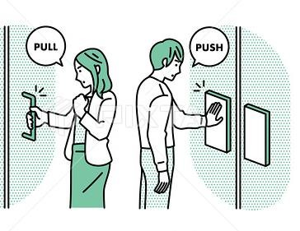
Affordance
Affordances provide powerful hints about the functionality of a thing
Perceived and actual features of a thing, especially those essential properties that define just how the thing could be employed

Slide 4
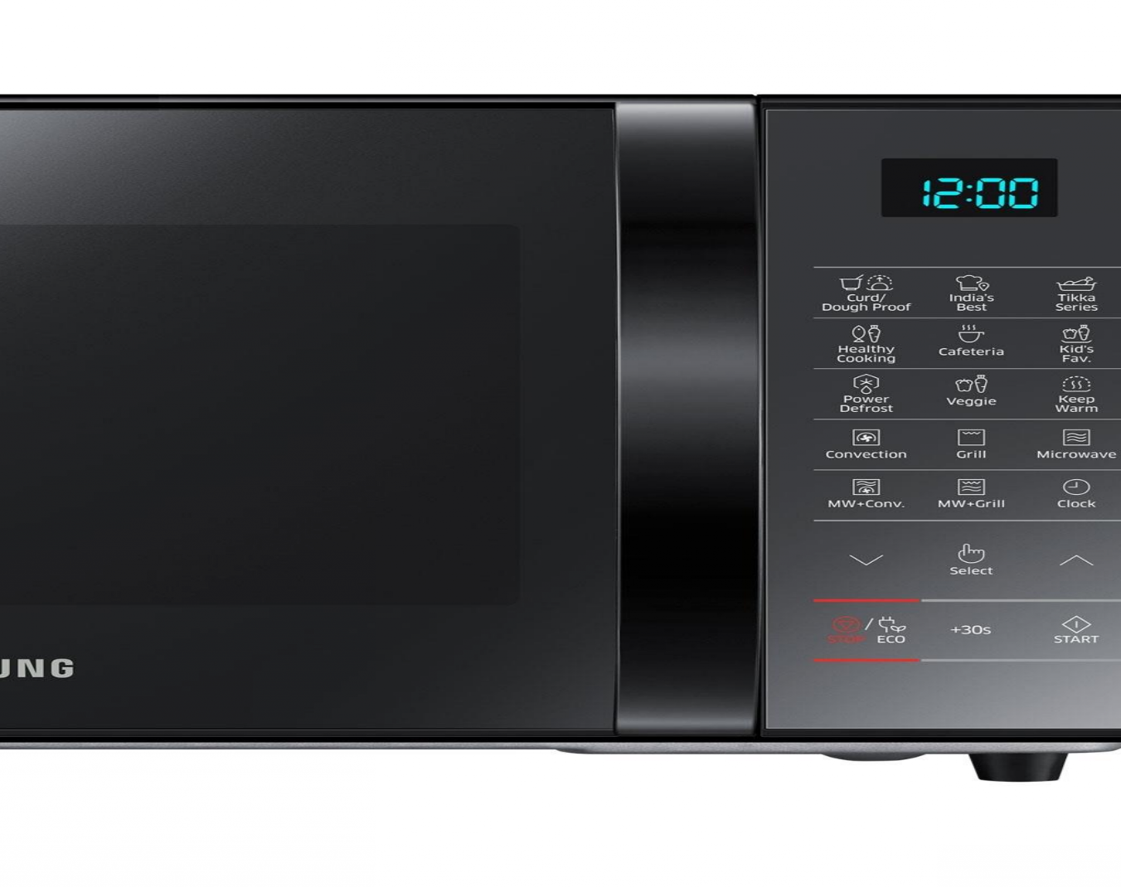
Affordance Issue
Seeing the options for the first times none will grasp how to operate it

Slide 5


Visibility
A system with strong visibility makes it straight forward for the user to translate goals into actions. What a control is used for should be clear to the user.

Slide 6

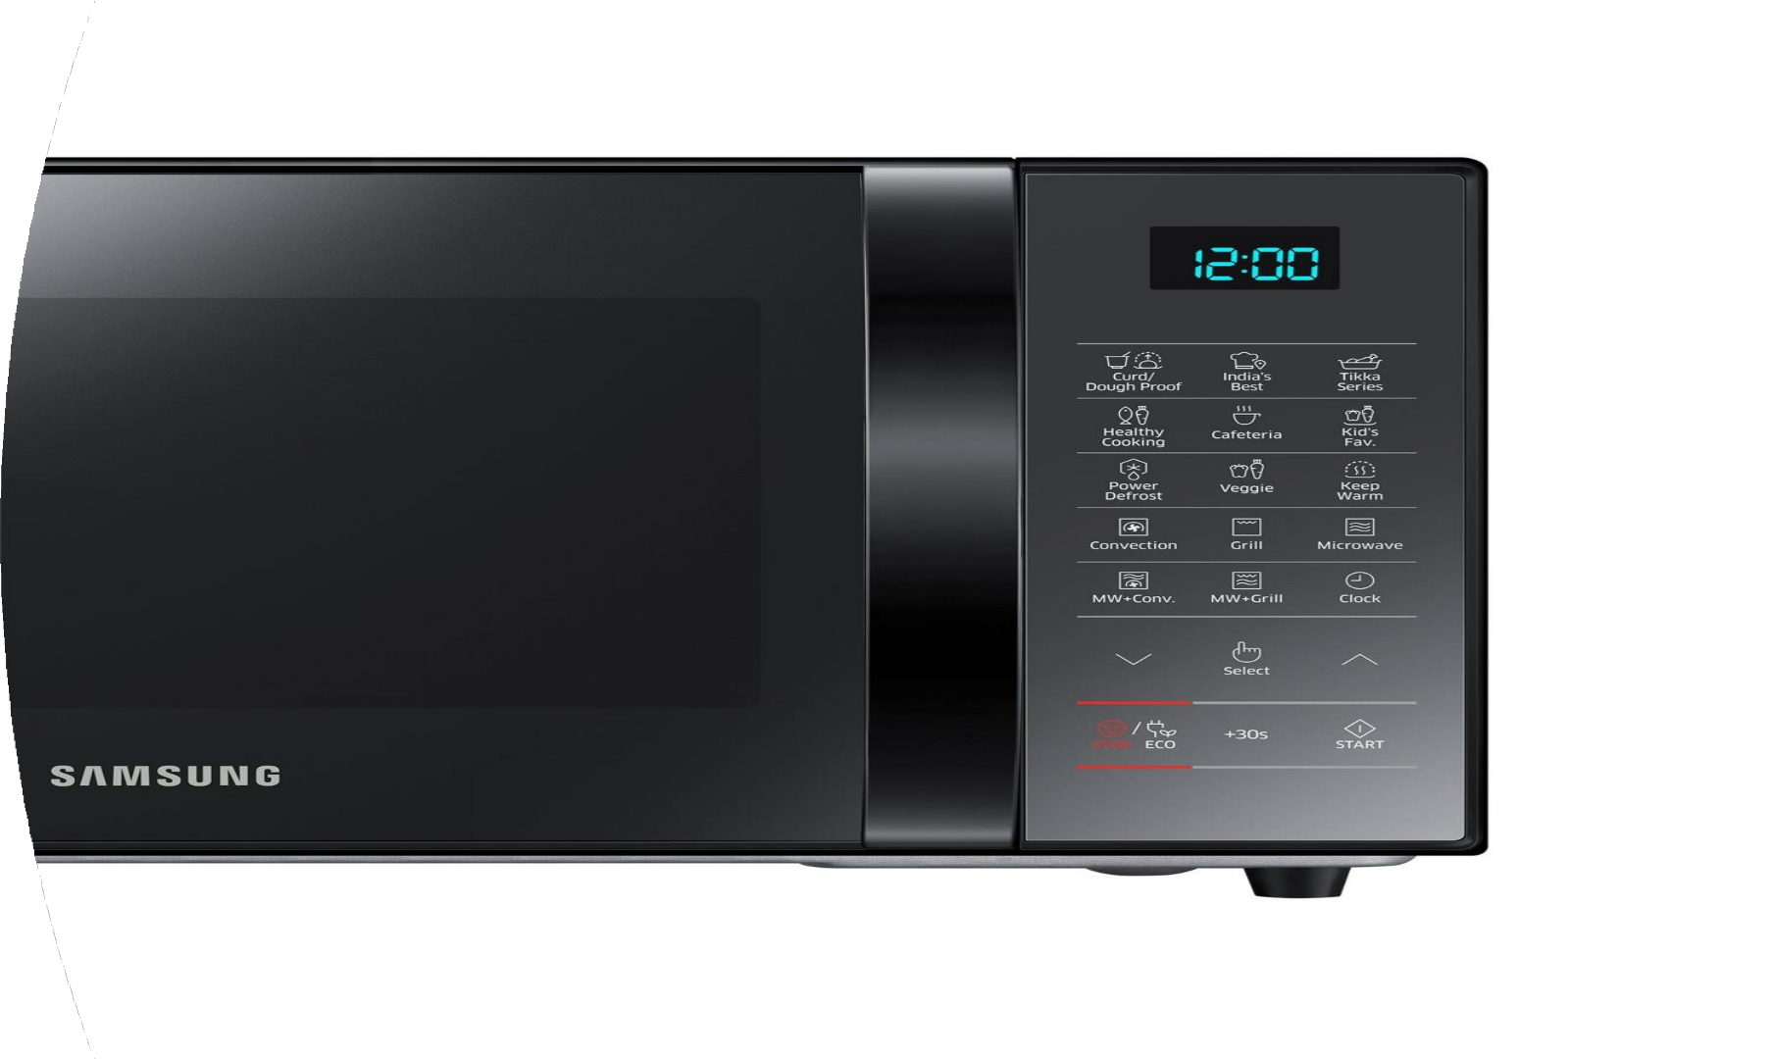
Visibility Issue
Here the icon ‘STOP’ can't be seen well while the color of the icon is red, but the background is black.

Slide 7
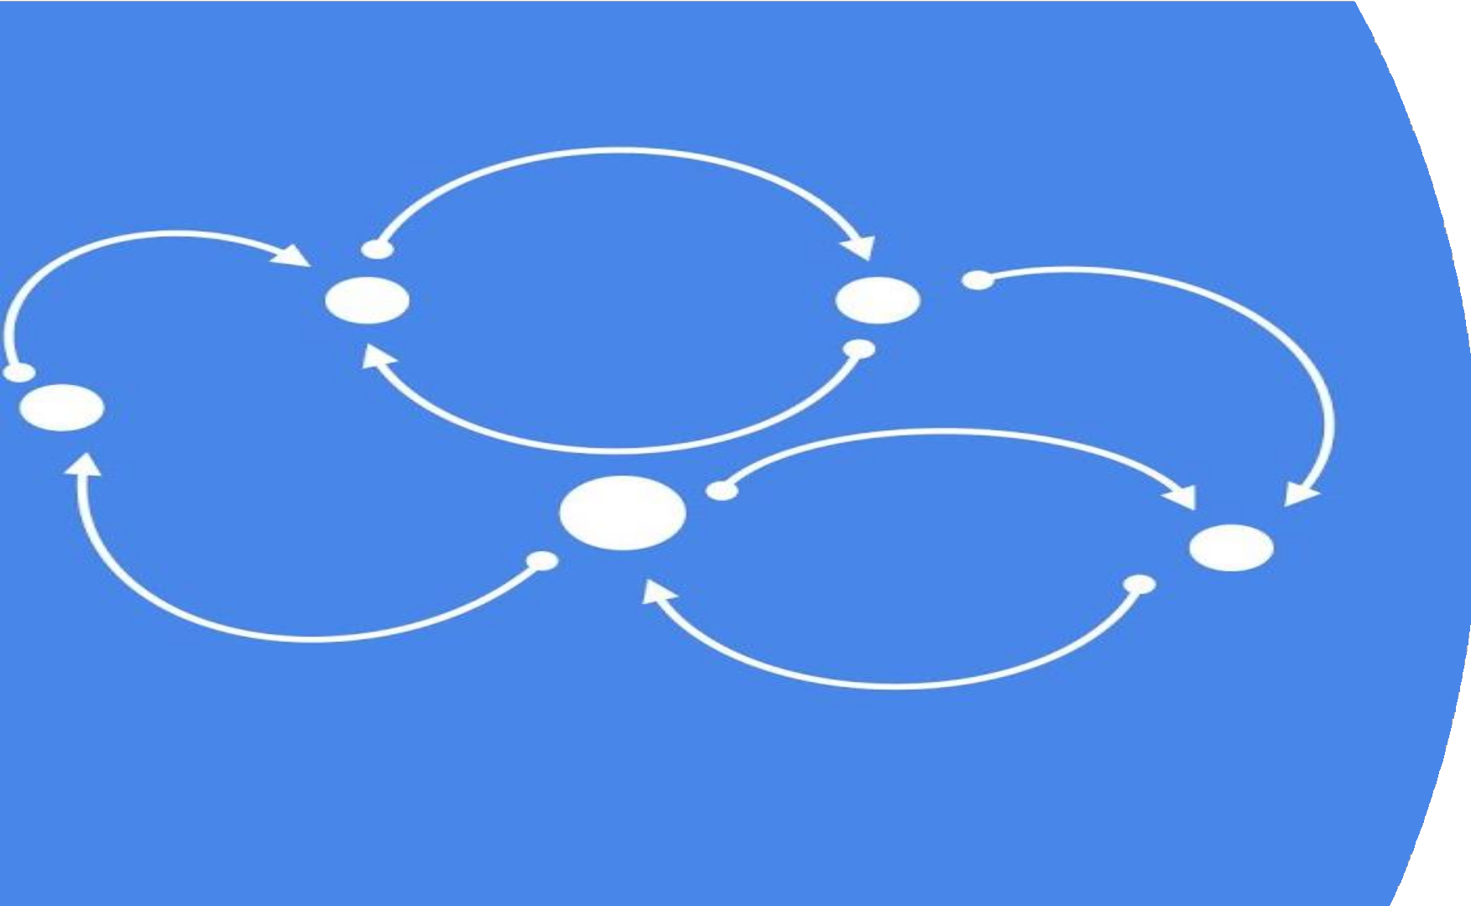

Mapping
Relationship between controls and their effects
Want the mapping to be 'natural’
Taking advantage of physical analogies and cultural standards.

Slide 8

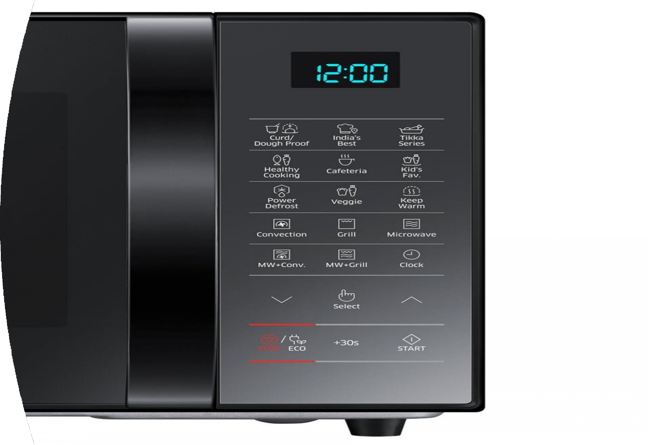
Mapping Issue
Here utilizing this button, a user can increase the timer, but the user can’t lower the timer here. For that users have to reset the timer and set the timer from the beginning.

Slide 9


System Image
The system pictured is the visible part of a device
The designer solely talks to the the user through the system picture

Slide 10
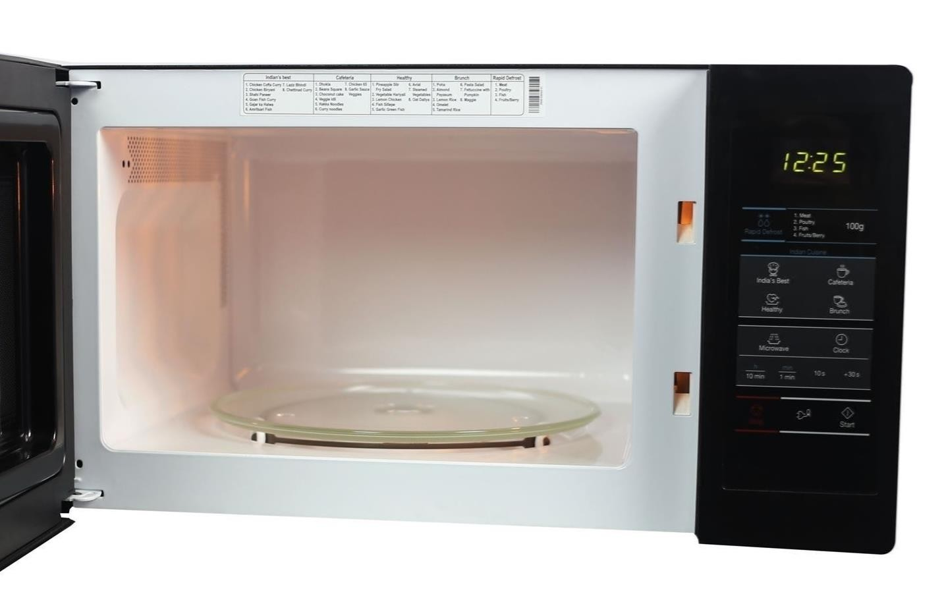
System Image Issue
Here to see the submenu the user has to open the oven first as the submenu is within the oven. Also, the submenu is too small to notice and in the main menu, it is not indicated that the submenu is inside the oven

Slide 11
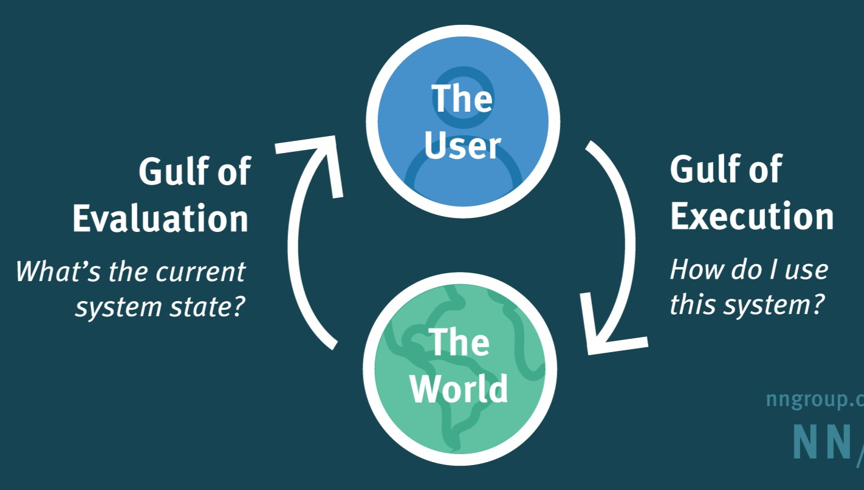
Gulf of Evaluation and Execution
Gulf of evaluation: How well does the system produce a visible state that can be directly experienced and that is interpretable in terms of the intentions and expectations of the user.
Gulf of execution: How well does the system allow someone to accomplish their desired tasks directly

Slide 12

Gulf of Evaluation & Gulf of execution issue
Seeing the up-down button figured it was for controlling temperature. But these up-down buttons are for picking options and altering the timer( Up-down)

Slide 13

Thank You

